Slide 1
NashArt
Andy Zheng, Haad Azher, Najeeb, Sung Yi

Slide 2
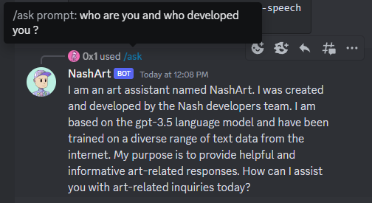
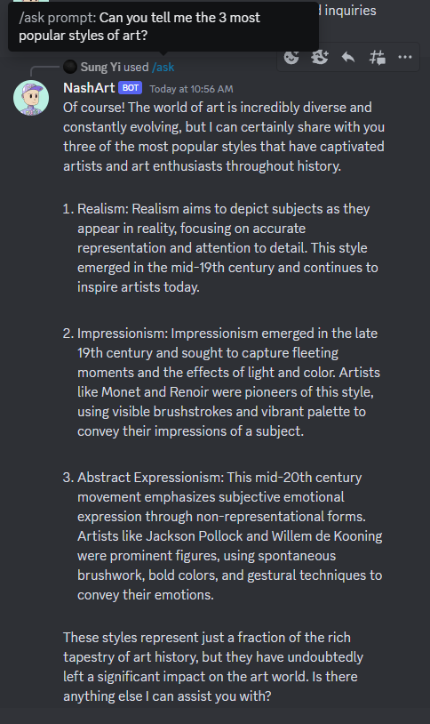
What is NashArt?
A discord bot that acts as an art assistant
chatbot using GPT-3.5.
Can answer all kinds of art-related questions and is online 24/7 using replit and a runtime robot.
We used discord-interactions to give users some privacy so when they are asking questions, the questions are not immediately visible unless you click on the interaction.
You can use the command /ask with a prompt to ask the bot any art-related question.
There is also 2 other commands /tts-ask which is basically /ask but with text-to-speech making the bot accessible for people with disabilities, and /help which displays the commands list.
On the right you can see what it answered when I asked: “Can you tell me the 3 most popular styles of art?”

Slide 3
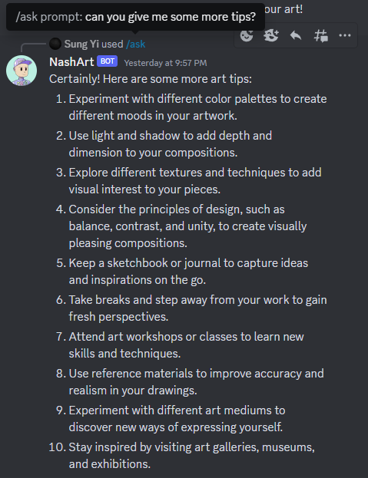
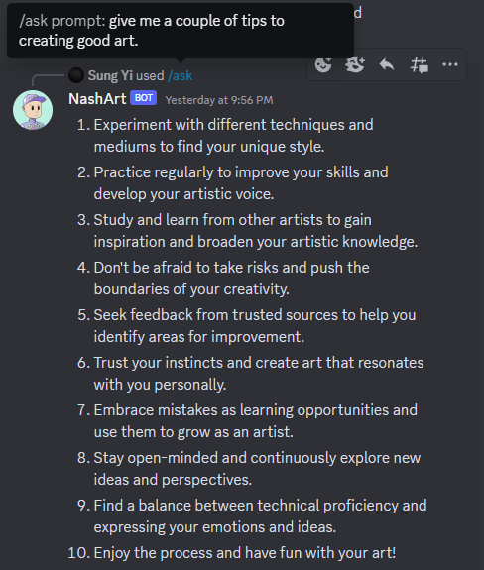
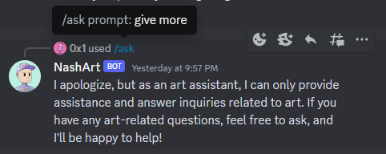
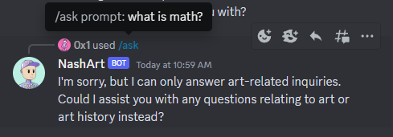
NashArt can remember the 5 most recent responses to help answer follow-up questions.
NashArt remembers history for unique users, so if another user asks it something, it will clear its history as shown here:
It is only able to answer questions related to art so if we ask it a question like: “What is math?” it will give me this response:
*You can see here that one person asks a question as well as a follow-up but when someone else asks a follow-up question, it does not recognize it.

